Slide 1
Module 4: Invoking Enterprise Integration Manager
Siebel EIM training
Notes:
Invoking Enterprise Integration Manager
COMPANY CONFIDENTIAL AND PROPRIETARY INFORMATION — DUPLICATION IS PROHIBITED
35.<number>
Time: Lecture: 35 – 40 minutes; labs: 70 – 95 minutes
Intent: To explain how to invoke an EIM task and verify the results.
Flow: Interface table structure; temporary columns; process for loading and verifying EIM tables; configuration file and associated options; EIM processing; disabling transaction logging for initial loads; invoking an EIM task; verifying EIM tasks; and clearing out EIM tables.
Key Terms:
Interface table (EIM table)
T_ column
.ifb file (configuration file)
Server Manager
IF_ROW_STAT column
Please note: Faculty-specific notes are italicized.

Slide 2

Module Objectives
After completing this module you will be able to:
  Understand and prepare Interface Tables
  Structure and Modify configuration (.ifb) files
  Invoke and Monitor an Enterprise Integration Manager (EIM) server task
  Verify EIM process completion.
Why you need to know:
  To successfully import external data into the Siebel database, perform batch updates/deletes and export information from Siebel base tables.
Notes:
Invoking Enterprise Integration Manager
COMPANY CONFIDENTIAL AND PROPRIETARY INFORMATION — DUPLICATION IS PROHIBITED
35.<number>

Slide 3
Interface Table Structure
All interface tables have three columns that must be populated in addition to the data that was mapped
  IF_ROW_BATCH_NUM, ROW_ID, IF_ROW_STAT
Number to identify all records that should be processed in the batch
Unique number to identify the record in the batch
Non-null character value which is reset during the run
IF_ROW_BATCH_NUM | Row_ID | IF_ROW_STAT | NAME
100 | 1 | FOR_IMPORT | Photocopier
100 | 2 | FOR_IMPORT | Fax Machine
200 | 1 | FOR_IMPORT | Shredder
200 | 2 | FOR_IMPORT | Toner Cartridge
FOR_IMPORT specifies that the row is for import; FOR_DELETE specifies delete
Notes:
Invoking Enterprise Integration Manager
COMPANY CONFIDENTIAL AND PROPRIETARY INFORMATION — DUPLICATION IS PROHIBITED
35.<number>
The example shows two different batches in the same table. Notice that ROW_ID does not need to be unique across batches. ROW_ID is unique only within a batch. Do not confuse this ROW_ID with a real Siebel ROW_ID on a base table. Also, it is necessary to provide some non-null character in the IF_ROW_STAT column.

Slide 4
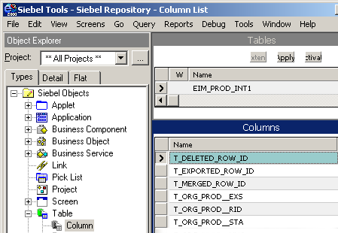
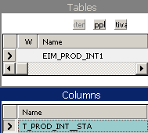
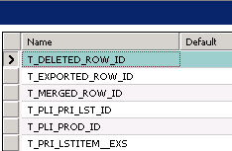
EIM T_ Columns
All interface tables have T_ columns to hold temporary values and status used during processing step
Temporary values
Status of target table
Notes:
Invoking Enterprise Integration Manager
COMPANY CONFIDENTIAL AND PROPRIETARY INFORMATION — DUPLICATION IS PROHIBITED
35.<number>
T_ columns that end with __STA are status columns and can provide additional troubleshooting assistance. Refer to the Siebel Enterprise Integration Manager Administration Guide.

Slide 5
Process Flow of Typical EIM Process
Prepare Interface Table
Edit Configuration file
Run EIM
Check results
Notes:
Enterprise Integration Manager
COMPANY CONFIDENTIAL AND PROPRIETARY INFORMATION — DUPLICATION IS PROHIBITED
2.<number>

Slide 6
Load EIM Tables
Load source data into EIM tables using non-Siebel process
  Use database vendor utilities such as DTS, bcp or SQL Loader to load data from flat files
  Use SELECT INTO to pull data from other SQL databases
  Write programs or stored procedures to cleanse or preprocess and insert rows
  Use direct SQL insert, update, or delete statements to update columns in EIM tables
External Data
EIM_PROD_INT
Non-Siebel process
Notes:
Invoking Enterprise Integration Manager
COMPANY CONFIDENTIAL AND PROPRIETARY INFORMATION — DUPLICATION IS PROHIBITED
35.<number>
The point here is that one is free to use whatever process works to load the data into the EIM table. Direct SQL insert, updates, and deletes are fully supported against EIM tables. Remember these tables do not have a Siebel-maintained ROW_ID column. In the lab, there will be an opportunity to use a DTS tool provided by the RDBMS vendor to load the data.

Slide 7
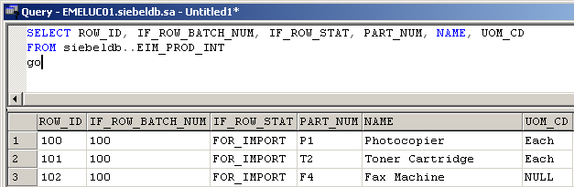
Verify EIM Load
Use SQL to verify the EIM tables loaded correctly
Update values using SQL if necessary
Notes:
Invoking Enterprise Integration Manager
COMPANY CONFIDENTIAL AND PROPRIETARY INFORMATION — DUPLICATION IS PROHIBITED
35.<number>
The point here is do not blindly load data and run EIM. Instead, be sure to verify that the EIM table contents are correct before proceeding.

Slide 8
Process Flow of Typical EIM Process
Prepare Interface Table
Edit Configuration file
Run EIM
Check results
Notes:
Enterprise Integration Manager
COMPANY CONFIDENTIAL AND PROPRIETARY INFORMATION — DUPLICATION IS PROHIBITED
2.<number>

Slide 9
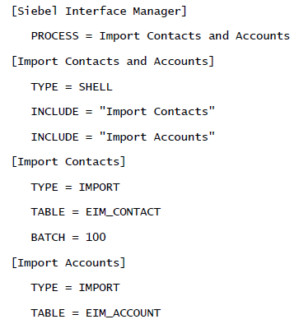
Configuration (.ifb) file
Specifies EIM process to perform (import, update, etc…) and relevant parameters.
Resides in the Siebel Server/Admin directory.
Header Section
Process Section
Sub-processes
Process type
IF_ROW_BATCH_NUM value - rows to process
Interface table
Notes:
Invoking Enterprise Integration Manager
COMPANY CONFIDENTIAL AND PROPRIETARY INFORMATION — DUPLICATION IS PROHIBITED
35.<number>
- Describe basic structure of ifb file.
3 Mandatory parameters of each process are TYPE, TABLE, BATCH
- IF_ROW_BATCH_NUM and must be a
positive integer between 0 and 2147483647 (no commas)
e.g. of batch parameters:
BATCH=100,103,104
BATCH=100-120

Slide 10
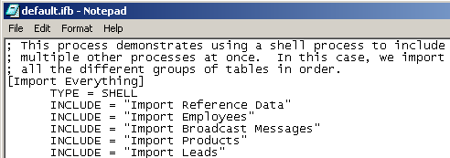
.ifb file – Processing Order
Determine the correct processing order for EIM tables
  When importing, tables referenced via foreign key must be
  loaded first
  Refer to the default.ifb and Siebel Bookshelf for recommended processing order
Order
Notes:
Invoking Enterprise Integration Manager
COMPANY CONFIDENTIAL AND PROPRIETARY INFORMATION — DUPLICATION IS PROHIBITED
35.<number>
Processing order is very important to EIM. Remember that the EIM process will look up data in one base table that is referenced by another base table to resolve and set the foreign key values. This means that if a base table has a foreign key pointing to another table, that other table must be loaded first. For example, if A points to B, then B must be loaded first.

Slide 11
Process Flow of Typical EIM Process
Prepare Interface Table
Edit Configuration file
Run EIM
Check results
Notes:
Enterprise Integration Manager
COMPANY CONFIDENTIAL AND PROPRIETARY INFORMATION — DUPLICATION IS PROHIBITED
2.<number>

Slide 12
Invoking EIM from command line
Launched from .bat files
Pragmatic examples:
  %CHEMINBIN%srvrmgr /g %SIEBEL-GATEWAY% /e %SIEBEL-ENTREPRISE% /s %SIEBEL-SERVER% /u %SIEBEL-USER% /p %SIEBEL-PASS% /c "Run task for component EIM with Config=%IFB_FILE%, LovLang=FRA, SQLFlags=1, ErrorFlags=1,TraceFlags=1,Process=%process%, ExtendedParams=\"%PARAM%\"“
  d:\sea77\siebsrvr\bin\srvrmgr /g MRUDV /s SIEB_SVR_DEV /e SIEBEL_DEV /u SADMIN /p SADMIN /c "run task for component EIM with CONFIG=%1,LovLang=%2"
Notes:
Invoking Enterprise Integration Manager
COMPANY CONFIDENTIAL AND PROPRIETARY INFORMATION — DUPLICATION IS PROHIBITED
35.<number>
This slide illustrates different implementations of invoking an EIM process through command line (with parameters)

Slide 13
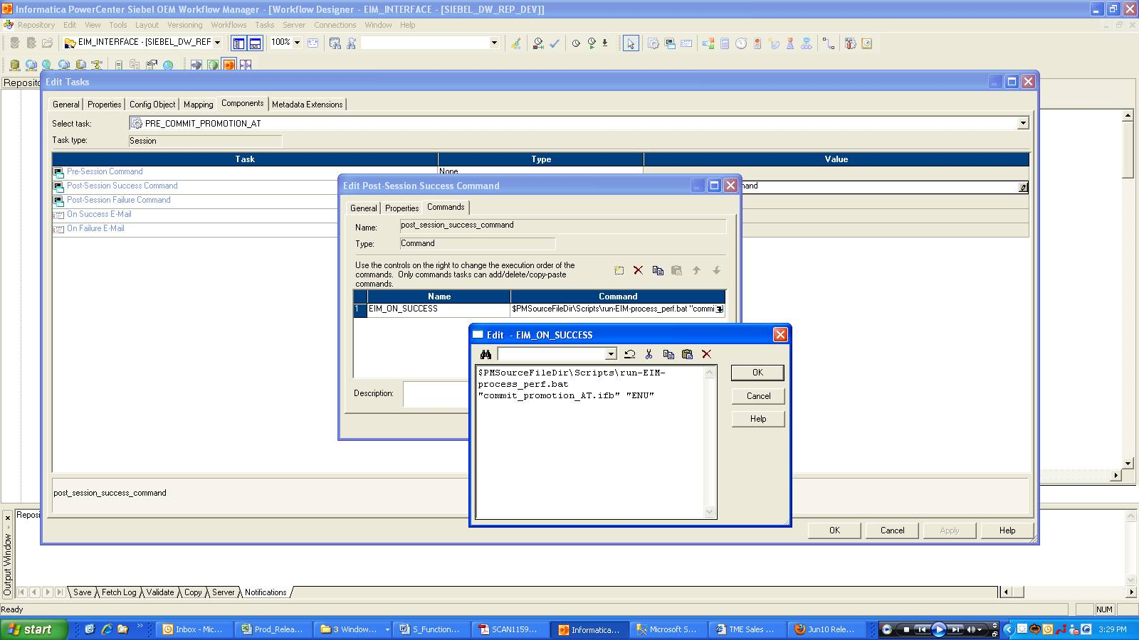
Invoking EIM from command line (cntd.)
Notes:
Invoking EIM from command line automatically after workflow completion
Invoking Enterprise Integration Manager
COMPANY CONFIDENTIAL AND PROPRIETARY INFORMATION — DUPLICATION IS PROHIBITED
35.<number>

Slide 14
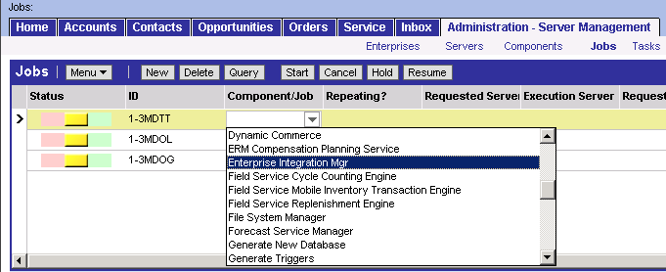
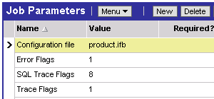
Invoking EIM from Application
Navigate to Administration - Server Management > Jobs
3. Click Start
1. Create new request and select Enterprise Integration Manager
2. Specify parameters
Notes:
Invoking Enterprise Integration Manager
COMPANY CONFIDENTIAL AND PROPRIETARY INFORMATION — DUPLICATION IS PROHIBITED
35.<number>
This slide illustrates steps to create an EIM task through the application.

Slide 15
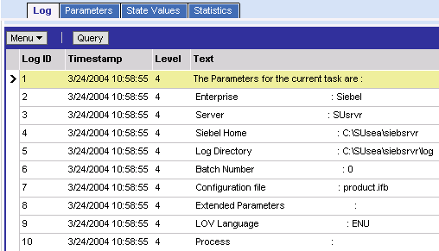
Monitor EIM Task
Navigate to Administration - Server Management > Tasks
  Query to view progress
  Review Task Information Log
Notes:
Invoking Enterprise Integration Manager
COMPANY CONFIDENTIAL AND PROPRIETARY INFORMATION — DUPLICATION IS PROHIBITED
35.<number>
This slide illustrates how to monitor an EIM task using Server Manager.

Slide 16
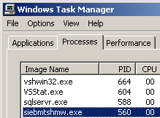
Running an EIM Task
Creates an operating system (OS) process that writes log entries, reads the .ifb file, loads the dictionary, and executes EIM steps
Example:
Dictionary
EIM
Siebel
Server
OS process
.ifb
log
Notes:
Invoking Enterprise Integration Manager
COMPANY CONFIDENTIAL AND PROPRIETARY INFORMATION — DUPLICATION IS PROHIBITED
35.<number>
The dictionary files are created automatically by server tasks. Once they are created they are used to speed processing time. If the files are removed they will be re-generated automatically.
The example shows a Windows process.

Slide 17
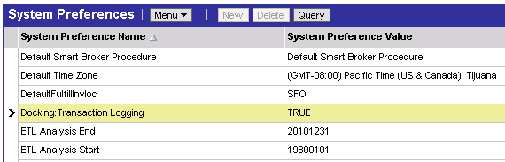
EIM and Transaction Logging
Transactions are logged during EIM to synchronize mobile clients
  Before initial loads, turn off logging
    Navigate to Administration - Application > System Preferences
  After initial loads, turn on logging to support mobile clients
Notes:
Invoking Enterprise Integration Manager
COMPANY CONFIDENTIAL AND PROPRIETARY INFORMATION — DUPLICATION IS PROHIBITED
35.<number>
Turning off logging during initial loads will greatly improve performance for large amounts of data.

Slide 18
Process Flow of Typical EIM Process
Prepare Interface Table
Edit Configuration file
Run EIM
Check results
Notes:
Enterprise Integration Manager
COMPANY CONFIDENTIAL AND PROPRIETARY INFORMATION — DUPLICATION IS PROHIBITED
2.<number>

Slide 19
Verify EIM Task
Verify EIM task using:
  SQL against the EIM and base tables
  Client application to view data
  Log files to troubleshoot
Notes:
Invoking Enterprise Integration Manager
COMPANY CONFIDENTIAL AND PROPRIETARY INFORMATION — DUPLICATION IS PROHIBITED
35.<number>
This is a positioning slide. Items are discussed in detail on subsequent slides.

Slide 20
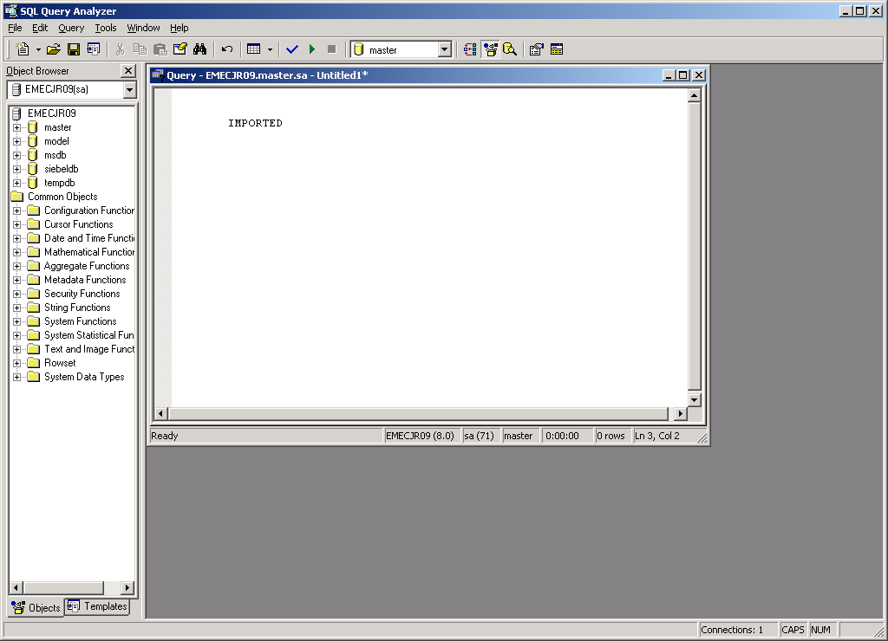

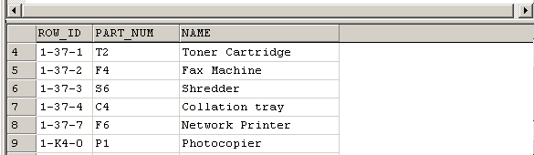
Verify Tables
Run SQL SELECT statements to verify the table data
Notes:
Invoking Enterprise Integration Manager
COMPANY CONFIDENTIAL AND PROPRIETARY INFORMATION — DUPLICATION IS PROHIBITED
35.<number>
Verify the values in the EIM table were properly set in the target base tables. This example is using MS SQL Server syntax in Query Analyzer. One must use a database tool. Siebel Systems does not provide an interactive SQL utility for server databases, although dbisql.exe is provided for SQL Anywhere local databases.

Slide 21
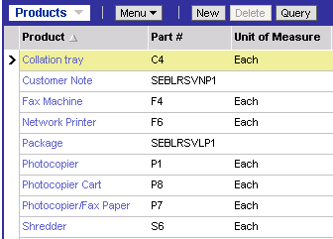
Verify Information in Application
Verify product information is in the application using appropriate views
  Example: Administration - Product
Verify products were imported successfully
Notes:
Invoking Enterprise Integration Manager
COMPANY CONFIDENTIAL AND PROPRIETARY INFORMATION — DUPLICATION IS PROHIBITED
35.<number>
Make sure the data is visible in the appropriate views in the application. Data may not be visible in other views if teams or owners were not imported.

Slide 22
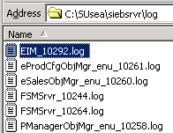
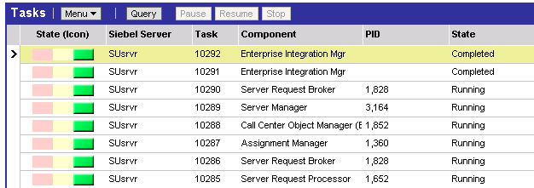
Verify Log Files
Use log files to troubleshoot
Error information
Corresponds to task number
Notes:
Invoking Enterprise Integration Manager
COMPANY CONFIDENTIAL AND PROPRIETARY INFORMATION — DUPLICATION IS PROHIBITED
35.<number>
One can also view the logs in the application.
Failures and errors on secondary tables of little importance may be encountered. EIM will do as much work as it can and provide notification of any errors. When errors are encountered, they may not indicate a failure and should be investigated.

Slide 23
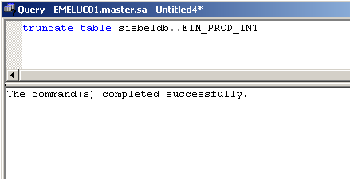
Remove Data from EIM Tables
You are responsible for removing records from the EIM tables
  Use SQL to delete EIM table records once they have been successfully processed
Notes:
Invoking Enterprise Integration Manager
COMPANY CONFIDENTIAL AND PROPRIETARY INFORMATION — DUPLICATION IS PROHIBITED
35.<number>
Clearing out data from the EIM tables is a good programming practice.

Slide 24
Summary
This module showed you how to:
  Understand and prepare Interface Tables
  Structure and Modify configuration (.ifb) files
  Invoke and Monitor an Enterprise Integration Manager (EIM) server task
  Verify EIM process completion.
Notes:
Invoking Enterprise Integration Manager
COMPANY CONFIDENTIAL AND PROPRIETARY INFORMATION — DUPLICATION IS PROHIBITED
35.<number>
True or false: SQL can be used to insert data into an EIM table without compromising referential integrity.
Review Question: What is the purpose of turning off transaction logging during initial loads?

Slide 25
Lab
In the labs you will:
  Use the Enterprise Manager’s Data Transformation Services facility to load external solution data from a file into the appropriate EIM interface table
  Run an EIM task to load the S_RESITEM base table from the EIM_SOLUTION interface table
Notes:
Invoking Enterprise Integration Manager
COMPANY CONFIDENTIAL AND PROPRIETARY INFORMATION — DUPLICATION IS PROHIBITED
35.<number>
See lab instructions for details.

